Slide 1

Data Science With Kedro
Rajesh More

Slide 2
Kedro is open source python framework used to make end to end data science project.
Creates Beautiful Skeleton - Pip Install Kedro command.
Install All Dependencies- pip install src/requirement.txt

Slide 3
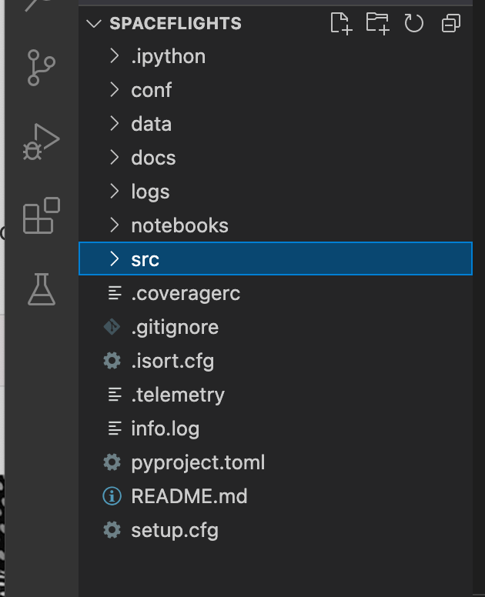
Conf:- We can configure the catalog, parameters, credentials, logging. Kedro specific configuration is loaded using the configuration class.
Data:- data folder stores the actual data, model outputs and results.
Docs:- We can bundle our project using python package.We can generate project specific documentation. “kedro build-docs” will generate html file.
Logs:- we can store logs generated by our logging.yml file.
Notebooks: we can use notebooks for EDA, for experimentation of creating new nodes.
Src:- Project source code

Slide 4
We will cover CONF and SRC folder in detail:
Conf:- We can save project specification files.
Two Subfolders:
Base: For project specific settings to share across different installations(e.g. with different users).
E.g. - catalog.yml-It’s a kind of Menu card in hotel. We can point out where we stored our input and output data.
E.g. - logging.yml - We can set different logging levels and messages to debugging and tracking purpose.
E.g. parameters.yml - train/test split, hyperparameter tuning.
Local: It is used for settings that should not be shared e.g. access credentials

Slide 5
SRC Folder:
Contains Pipeline.py and Nodes.py files
Node.py:- Node is a wrapper function that names the input and output of that function. We need to make python functions for each step e.g. preprocess nodes to preprocess our data or model training node to evaluate our model.
Pipeline: Connects the nodes. It’s a ordered execution of node.
Node 1
Node 2
Node 3
Data Processing Pipeline
Node 1
Node 2
Node 3
Data Science Pipeline
Join two pipelines in pipeline_registry.py
"__default__": data_processing_pipeline + data_science_pipeline,

Slide 6
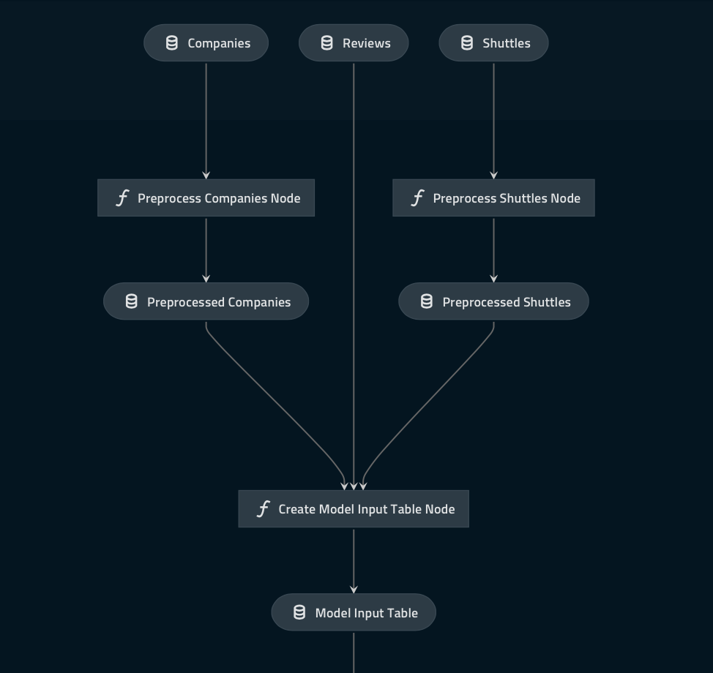
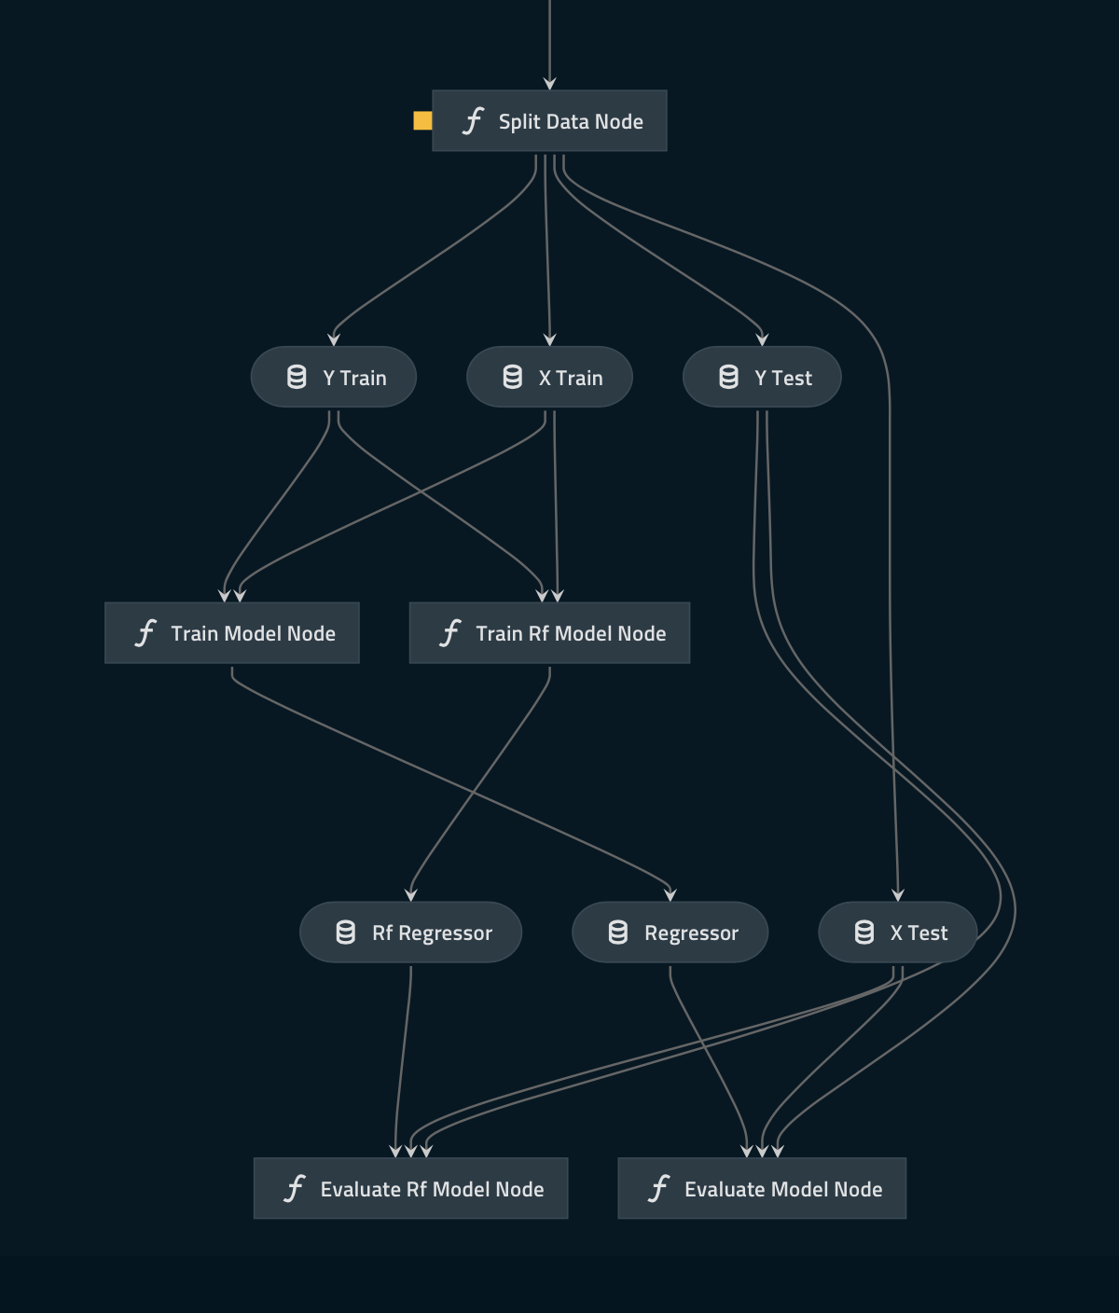

Slide 7
Precautions:
We should avoid committing credentials in “Conf”. Best practice is- Use only “conf/local” folder to save sensitive information like access credentials.
Avoid committing notebook output cells(data can easily sneak into notebooks if we don’t delete the output.
We should avoid committing data to version control.

Slide 8
Thank You

